Slide 1
Health Level 7 (HL7)
Satish Patel

Slide 2
Health Level 7 (HL7)
Communication standard in healthcare arena
Represent the application layer (7th layer) in the OSI reference model
Developed by ANSI accredited Standard Developing Organization

Slide 3
HL7 Versions
Version 2.x
  Large scale adoption
  Variable length using vertical bars for message encoding
  Very little interoperability
Version 3.0
  XML based structure for message encoding
  Early stage of adoption
  Emphasis on true interoperability

Slide 4
HL7 Foundation Components
Reference Information Model
  It is a model from which all other information models and message specifications are derived
Data Type Specification
  Defines structural format of the data carried in an attribute and influences set of allowable values an attribute may assume
Vocabulary Specification
  Defines the set of all concepts that can be taken as valid values in an instance of a coded attribute or data type property
Source: HL7 V3 Reference Model by AbdulMalik Shakir

Slide 5
HL7 Foundation Components
Reference Information Model
Data Type
Specification
Vocabulary
Specification
Source: HL7 V3 Reference Model by AbdulMalik Shakir

Slide 6
Reference Information Model

Slide 7
Reference Information Model (RIM)
Structured specification for the information of interest
Based on Unified Service Action Model (USAM) principles
Base object model for HL7 V3
Ideally can represent any information in the universe
All information models are subset of the common model

Slide 8
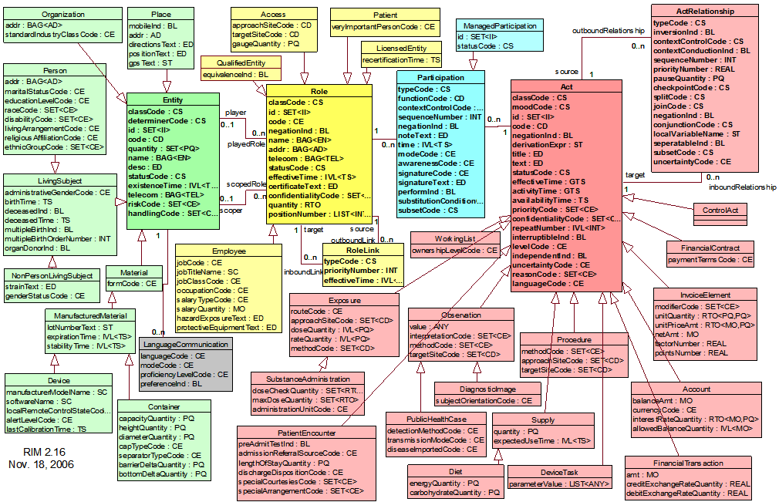
HL7 RIM - UML Model

Slide 9
Basic RIM Structure
RoleLink
ActRelationship
typeCode : CS
typeCode : CS
outboundLink
0..n
0..n
inboundLink
outboundRelationship
0..n
0..n
inboundRelationship
source
1
1
target
source
1
1
target
Entity
Role
Participation
Act
id : II
classCode : CS
code : CD
determinerCode: CS
statusCode : CS
player
0..n
id : II
classCode : CS
code : CD
statusCode : CS
id : II
classCode : CS
code : CD
typeCode : CS
statusCode : CS
id : II
classCode : CS
code : CD
moodCode : CS
statusCode : CS
effectiveTime : GTS
0..1
playedRole
1
0..n
0..n
1
scoper
0..n
0..1
scopedRole
Source: HL7 V3 Reference Model by AbdulMalik Shakir

Slide 10
Coded Attributes
Act.classCode
Act.moodCode
Act.statusCode
ActRelationship.checkpointCode
ActRelationship.conjunctionCode
ActRelationship.joinCode
ActRelationship.splitCode
ActRelationship.typeCode
ActRelationship.contextControlCode
Entity.classCode
Entity.determinerCode
Entity.statusCode
ManagedParticipation.statusCode
Participation.contextControlCode
Participation.typeCode
Role.classCode
Role.statusCode
RoleLink.typeCode
Source: HL7 V3 Reference Model by AbdulMalik Shakir

Slide 11
HL7 State Machine
States are defined for Entity, Role, ManagedParticipation and Act class
State machine specifies the valid state transition for any class
When a class transition from one state to another, it triggers an action and sometimes interaction with other HL7 based systems

Slide 12
Data Type Specification

Slide 13
HL7 V3 Data Types
Defines structure and constrains allowable values of attributes in the RIM model
It is a atomic building block that can be reused to create all V3 information structure
Currently XML ITS specifications are available for V3 data types

Slide 14
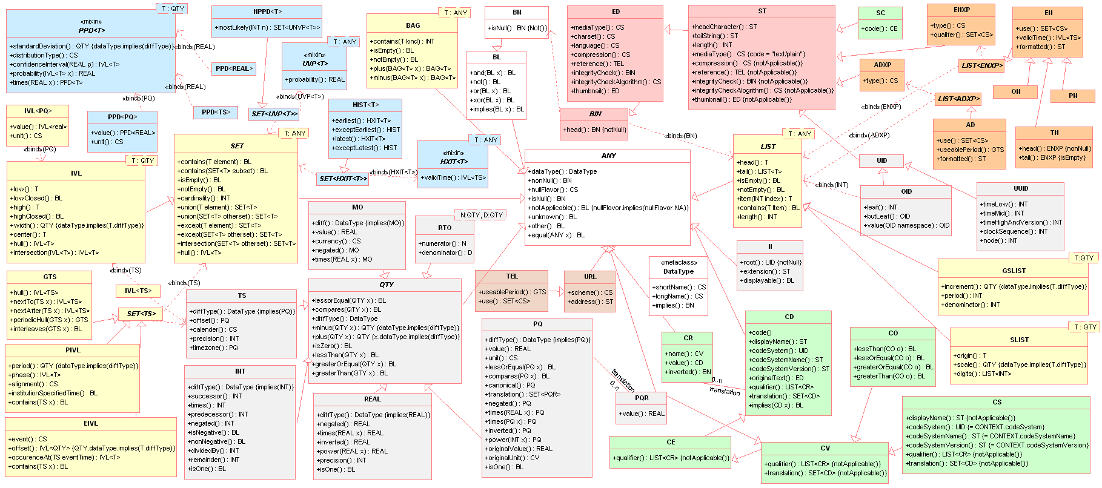
HL7 Data Types

Slide 15
Classification of Data Types
Quantity
  BIN
  BL
  INT
  MO
  PQ
  QTY
  RTO
  REAL
Generic Collections
  BAG
  SET
  IVL
  LIST
Timing Specification
  GTS
  TS
  PIVL
  EIVL
Character String
  ST
  ED
  SC
Entity Name
  PN
  EN
  TN
  ON
  ENXP
Address Types
  AD
  ADXP
  TEL
  URL
Identifier
  II
  OID
Coded Type
  CS
  CD
  CR
  CV
  CE

Slide 16
Vocabulary Specification

Slide 17
HL7 V3 Vocabulary
Vocabulary domain is collection of interrelated concepts
  Similar to the CDEs in caDSR
Value set is a collection of coded concepts from same code system (e.g. LOINC or SNOMED)
  Similar to Enumerated Value Domain in caDSR

Slide 18
Vocabulary Binding
Information Model
Vocabulary Binding
Vocabulary Terms
Class
Vocabulary Domain
Code System
0..1
0..1
1
0..*
1
0..*
0..*
0..*
0..*
0..*
Attribute
Value Set
Coded Concept
0..*
0..1
0..*
0..*
Source: HL7 V3 Reference Model by AbdulMalik Shakir

Slide 19
HL7 Vocabulary
RIM DMIM RMIM
MessageType
Message 1 Message 2
Act
classCode = ACT
moodCode = ActMood
Code = ActCode
Observation
classCode = OBS
moodCode = ActMood
Code = ObservationType
ObservationOrder
classCode = OBS
moodCode = ORD
Code = ObservationType
LabOrder
classCode = OBS
moodCode = ORD
Code = LabObservation
LabOrder(US)
classCode = OBS
moodCode = ORD
Code = LOINC
LabOrder(UK)
classCode = OBS
moodCode = ORD
Code = SNOMED

Slide 20
HL7 Messaging

Slide 21
Example
Adam arrives at hospital’s emergency room via ambulance on March 13, 2008 at 4PM.
Adam is respiratory distress and has accelerated heart beat.
The physician on duty, Dr. Eric feels he should be treated at this time.
Dr. Eric feels that Dr. Penny, a pulmonologist will be needed for consultation.
Adam is admitted.

Slide 22
Using RIM to Represent the Case
Act
  Act.Class = Encounter
  Act.code = Emergency
  Act.status = Active
  Act.mood = Event
  Act.effectiveTime = 200803131600
Role
  Role.type = Patient
Participation
  Dr Eric’s Participation.type = Admitter
  Dr. Penny’s Participation.type = Consultant
ActRelationship
  ActRelationship.type = Arrival

Slide 23
Interaction between Applications
Interaction uniquely specifies association between
  A trigger event
  Receiver’s responsibility
  Static message definition
Each participating application in message exchange has a pre-defined role
  Sending application roles: Informer, Placer
  Receiving application roles: Fulfiller, Tracker

Slide 24
Interaction Sequence
Hospital Planning System : Placer
Hospital Admission System1 : Fulfiller
Hospital Admission System2 : Fulfiller
Admission request
Admission request
Admission promise
Abort admission request

Slide 25
HL7 Messaging Domains
Administrative Domains
  Accounting and Billing
  Claims and Reimbursement
  Patient Administration
  Personnel Management
  Materials Management
  Scheduling
Common Use Domains
  Shared Messages
  Common Message Element Types
  Clinical Statement
Health and Clinical Practice
  Blood, Tissue and Organ
  Care Provision
  Clinical Decision Support
  Clinical Document Architecture (CDA)
  Clinical Genomics
  Imaging Integration
  Immunization
  Laboratory
  Medical Records
  Medication
  Orders and Observation
  Pharmacy
  Public Health Reporting
  Regulated Products
  Regulated Studies
  Specimen
  Therapeutic Devices

Slide 26
Steps to Define Message
Create Domain Message Information Model (DMIM) from RIM
  DMIM contains all information specific to a particular functional domain such as Patient Administration
  Attributes of RIM are constrained as needed
  RIM core classes are constrained as needed
  Provides multiple entry points in the information model
Create Refined Message Information Model (RMIM) from DMIM
  Similar to DMIM excepet for the entry points
  Can be developed using RMIM designer tool
Convert RMIM in Hierarchical Message Descriptor (HMD)
  Refinement of RMIM
Convert HMD into Message Type (MT)
  Refinement of RMIM
  Same format as HMD

Slide 27
HL7 Message Transport
Message Instance Information
HL7 Version Information
Participating application information
Response mode information
Transmission Wrapper
Control Act Wrapper
Message Content
Trigger event information
What was the event
When did event occur
Who performed the event
Who authorized the event

Slide 28
Questions

